Slide 1
Threat Modeling
By –Prakash Khasor, Assistant Professor(Cyber Security), National Forensic Sciences University

Slide 2
Introduction
What is Threat Modeling??
Why Threat Modeling?
Common Models ??

Slide 3
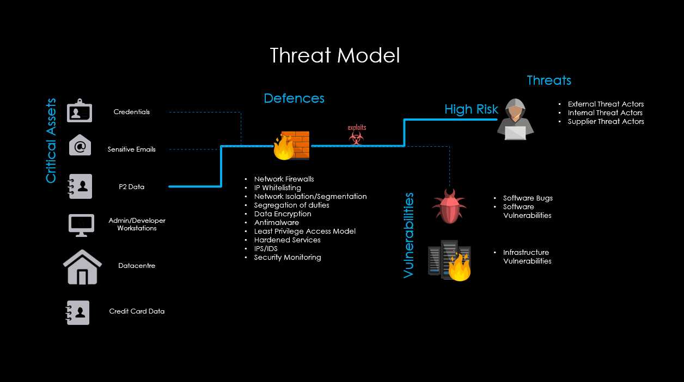
What is Threat Modeling
Threat modeling is a process by which potential threats, such as structural vulnerabilities or the absence of appropriate safeguards, can be identified, enumerated, and mitigations can be prioritized. (Wikipedia)

Slide 4
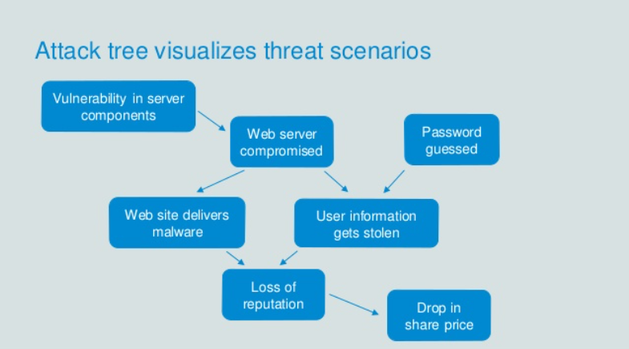
Why Threat Modeling?
4 Essential Steps:-
Diagram: what are we building?
Identify threats: what can go wrong?
Mitigate: what are we doing to defend against threats?
Validate: validation of the previous steps and act upon them

Slide 5
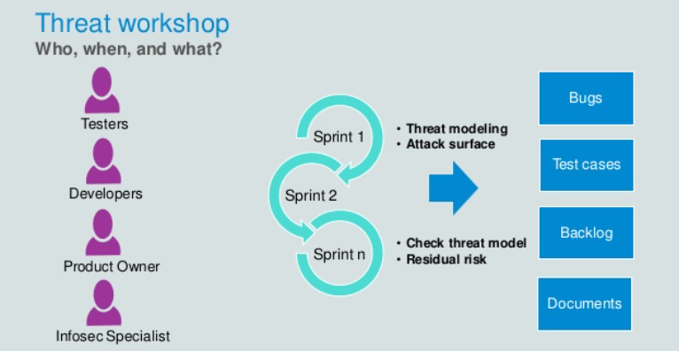
The Process

Slide 6
Common Models ??
SDL(Microsoft Security Development Cycle)
In this “Security in every stage of Development”
Secure the development by Design /Deploy / Default & Communication(“SD3+C”)
“”””Remove bugs and security flows from Design and Coding. “””
DREAD
-Damage Potential.
-Reproducibility
-Exploitability
-Affected Users
-Discoverability
Risk = (Damage Potential+Reproducibility
+Exploitability+Affected Users
+Discoverability)/5

Slide 7
Conti….
STRIDE
-Spoofing:- Authentication :- identity theft
-Tampering:- Integrity
-Repudiation:- Non-Repudiation
-Information Disclosure:- confidentiality
-Denial of Service:- Availability DOS and DDOS
-Elevation/Escalation of privilege:-Authorization
P.A.S.T.A
-Process for Attack Simulation and Threat Analysis
1.Vertical Escalation:-basic user ->admin
2.Horizontal Escalation:-
User a-> user b

Slide 8
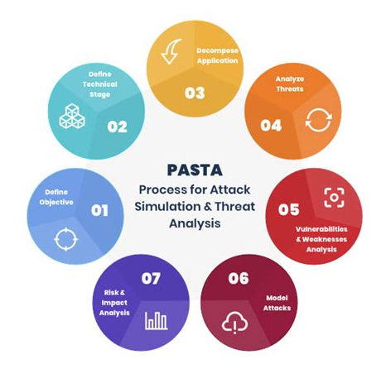
P.A.S.T.A
Define Objectives
Define Technical Scope
Decomposition & Analysis of Application
Threat Analysis
Vulnerabilities and Weaknesses Analysis
Attack/Exploit Enumeration and Modeling
Risk and Impact Analysis
Threat Mitigations,Identify trust boundaries, classification of the data assets,identify vulnerability and mitigation by proper design

Slide 9


